Slide 1
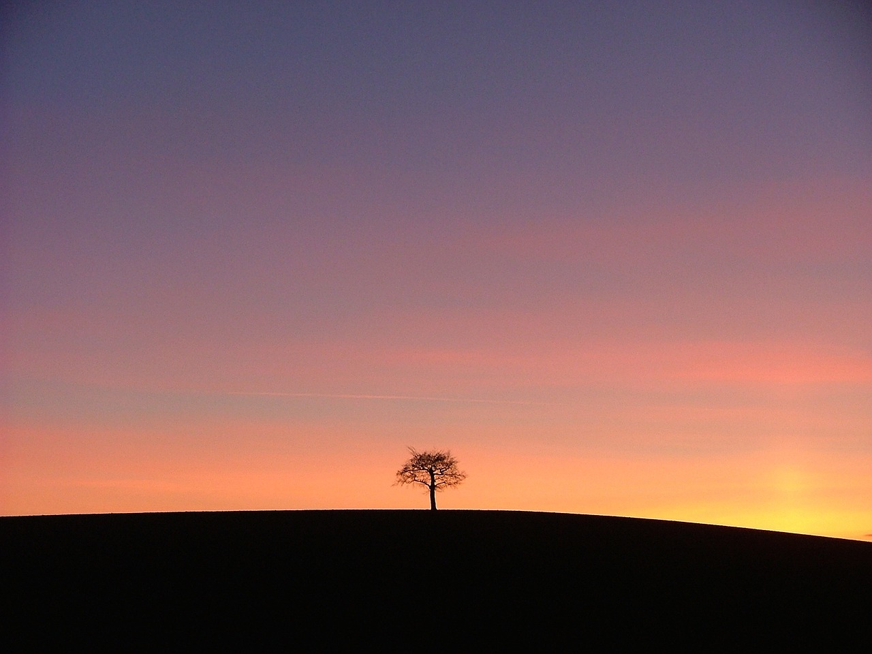

Group Haiku
Finding the essence of our content.
All images from Pixabay.com. Okay to reproduce without attribution.
Based on an activity developed by ETR. www.etr.org

Slide 2
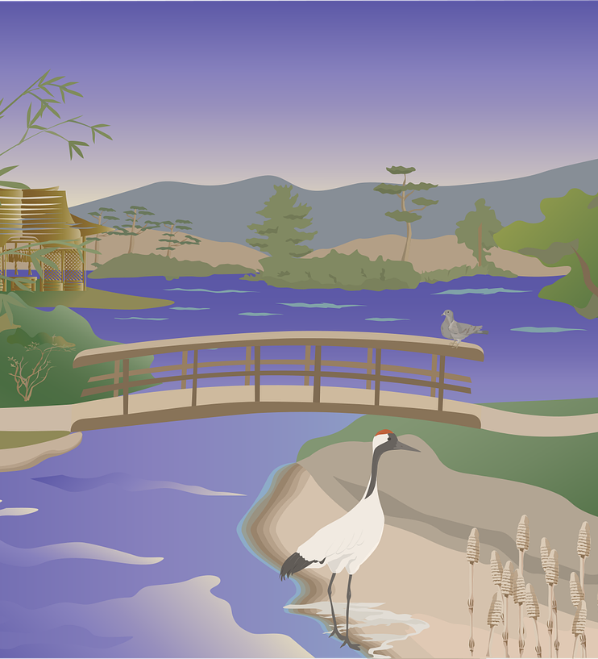
HAIKU
Started in 13th Century Japan
Three lines: 17 syllables
First line 5 syllables
Second line 7 syllables
Third line 5 syllables
Originally written in a group process
Why?

Slide 3
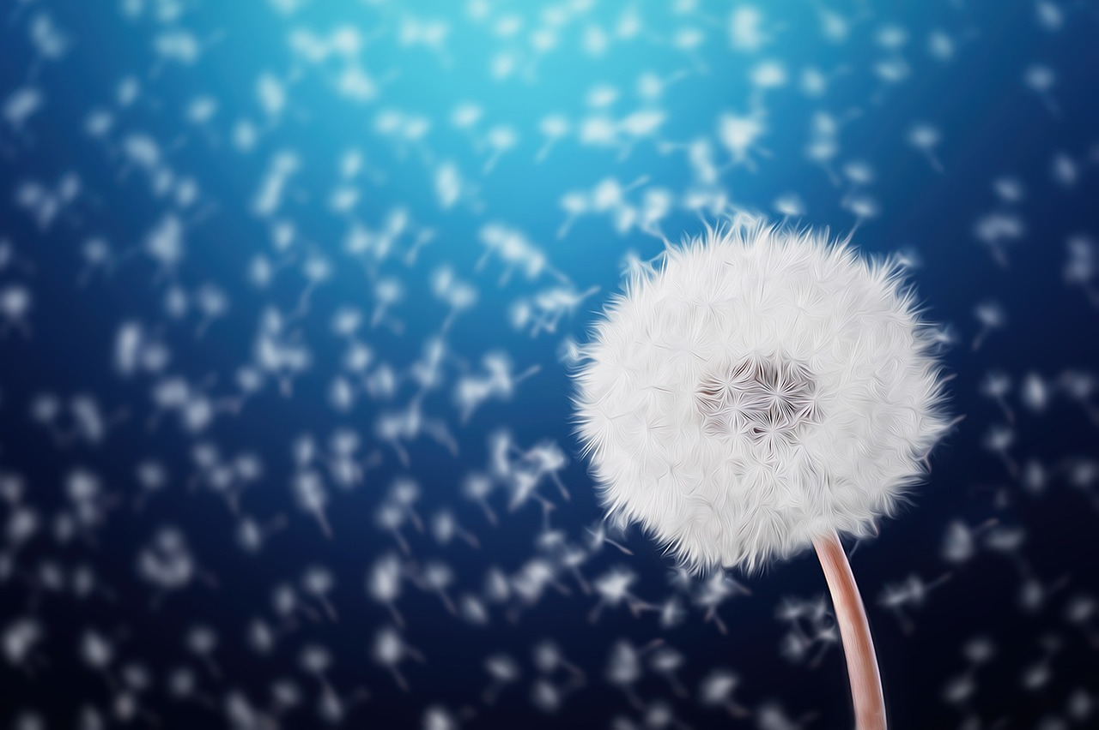
To note a moment in life or nature.

Slide 4

To think philosophically

Slide 5

To describe something with humor.

Slide 6

To get together to party and drink.

Slide 7

Work with your group.
1

Slide 8
haiku
2
Choose a Recorder
and a Reporter.

Slide 9
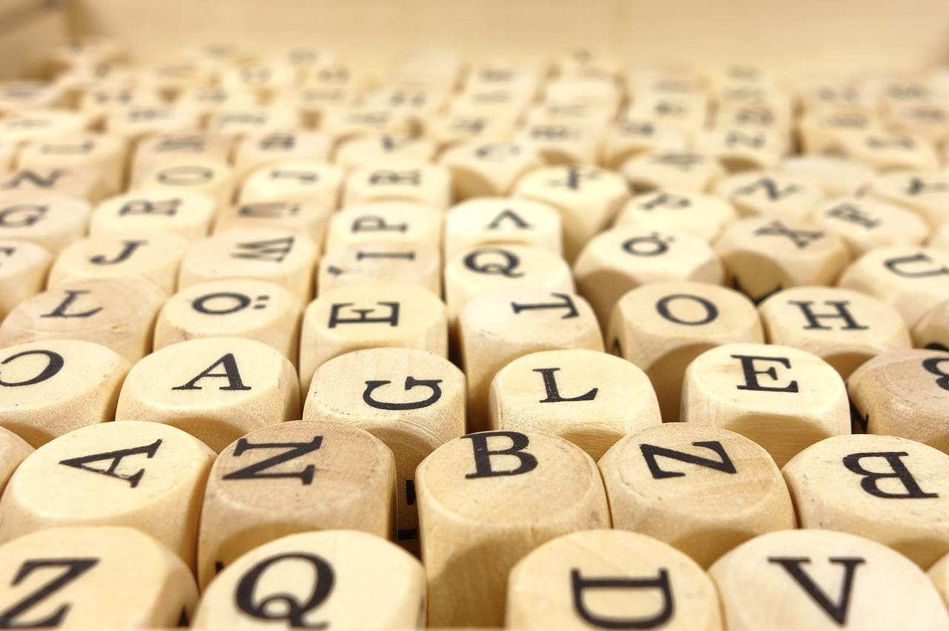
Write down some words that reflect your thoughts and impressions about the content we’re reviewing.
3

Slide 10
4
Write your group Haiku.
Line one gets just five.
Line two, seven syllables.
Line three? Five again.

Slide 11
Insights?

